Slide 1
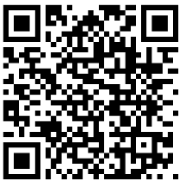
To begin requesting a transcript, scan this QR code or click the link on our website!

Slide 2
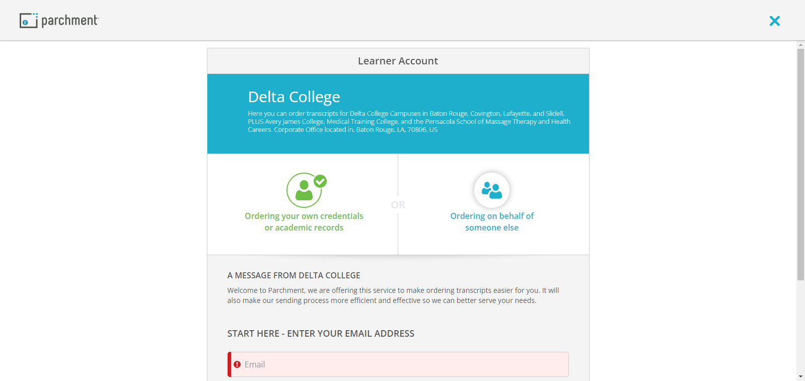
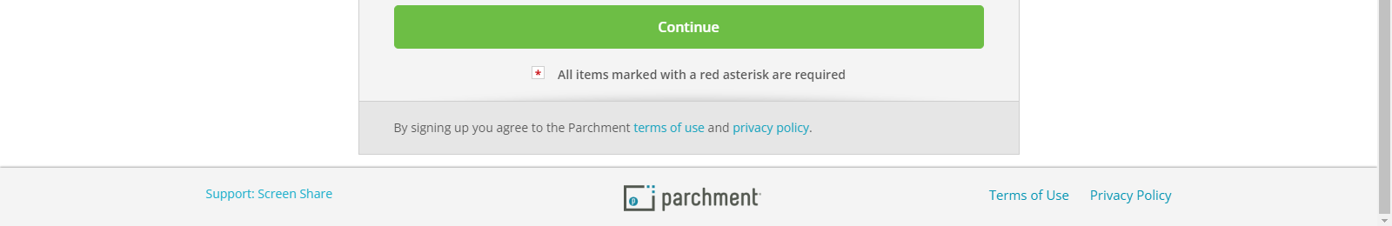
Notice the name here will say Delta College, this is correct even if you are not a Delta College Graduate because this account is through our Corporate office which manages several schools
Upon clicking the link on the website You will be brought to this page where you will enter your email
Please Read here to see which campuses / Schools you can order transcripts from

Slide 3
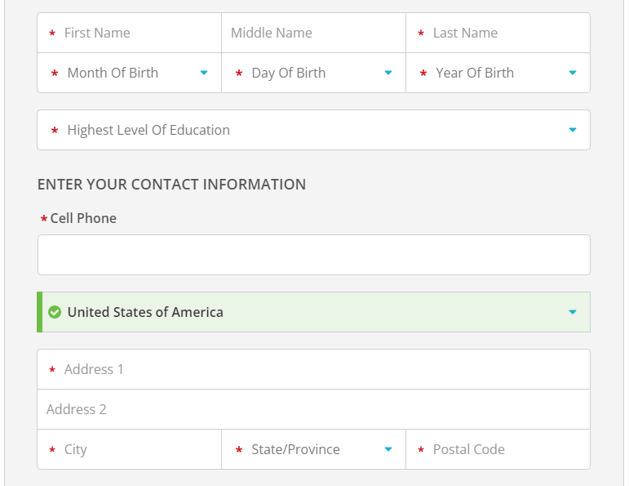
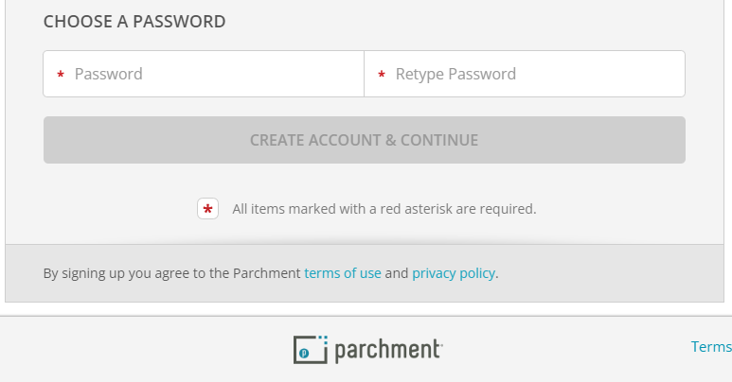
On the next page you will need to enter all of the following information that is required to create your account

Slide 4
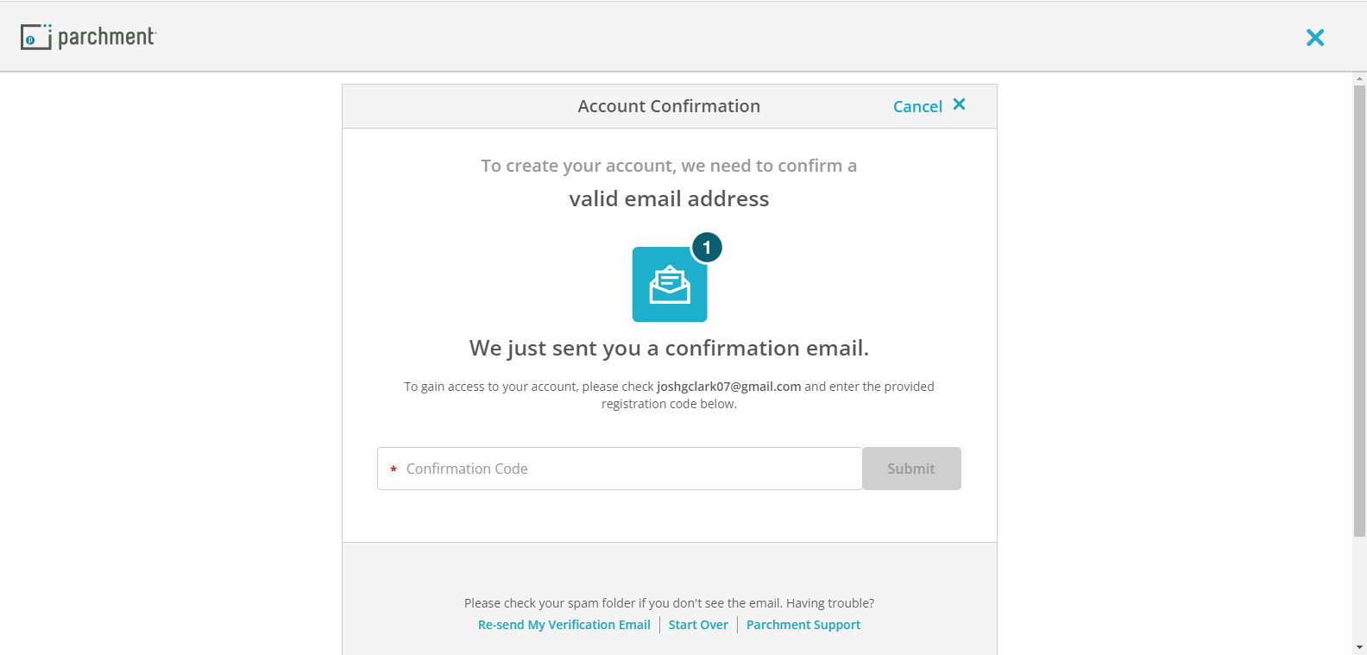
The next page will require you to check the email you provided and input your confirmation code that should come through in 1 to 2 minutes.

Slide 5
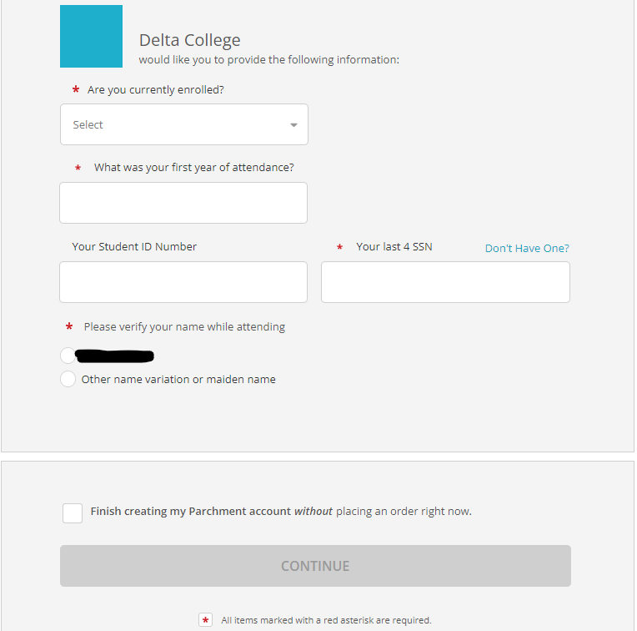
After confirming your email you will need to input the information pictured here with a red *
Note: you do not need a student ID Number
If you wish to request your transcript right away you click continue.
If you would like to create your account but want to request a transcript at a later date then you can check this box

Slide 6
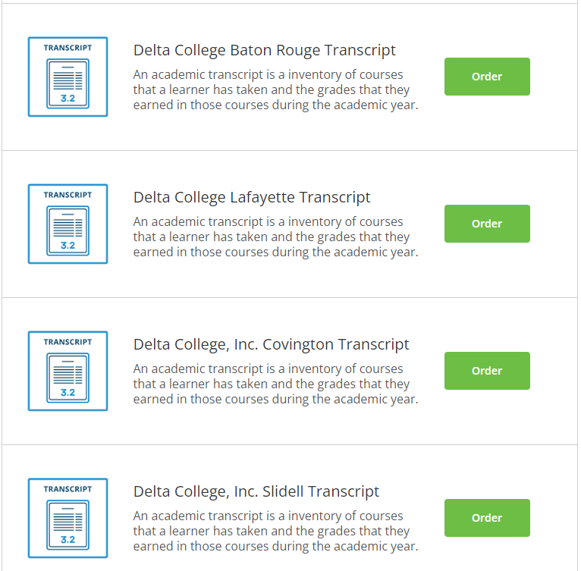
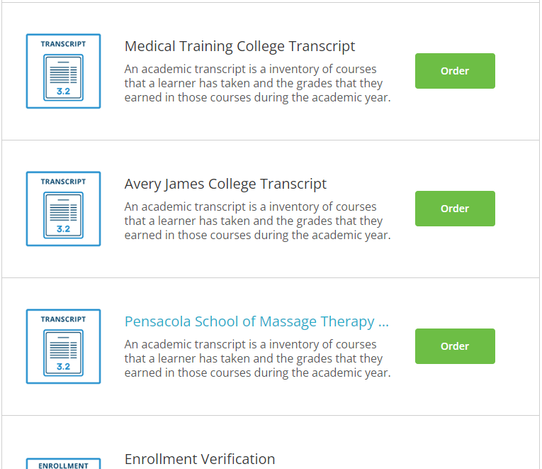
Congratulations!
Now you are where you can request your transcript!
It is here you will see and select the school from which you graduated to request your transcript!

Slide 7
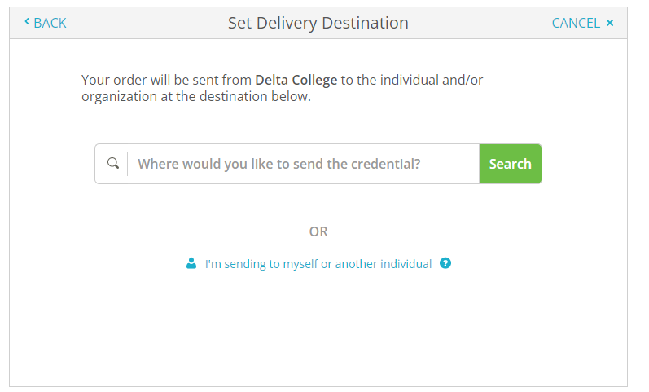
From here you will need to proceed according to the requirements of where you want your transcript sent.
You will have the option to send it to yourself, to another person or institution, or to another school.
If your school does not show up in the search you can still provide a institution name and address or email (depending on the method of transfer) and have it sent wherever you need it to be sent!

